Slide 1
Sensor Network using Arduino Fio
Nripun Sredar
Shaunak Vairagare
Sujeet Kuchibhotla

Slide 2
Components
Command Station
PC
Xbee Radio
Xbee Explorer Adapter
Sensor Station
Arduino Fio
Xbee radio
Temperature Sensor/ Moisture Sensor

Slide 3
Configure Xbee Radios

Slide 4
Wireless programming using Arduino IDE

Slide 5
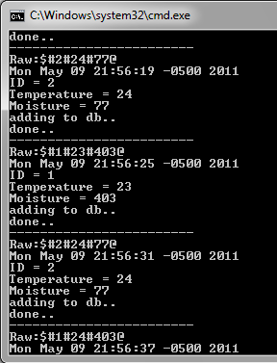
Wireless Serial Communication
Message Format
$#ID#temp#moist#batt@
Transmission Range
300 ft (line of sight)

